Slide 1
http://www.vidyanidhi.com/
ketkiacharya.net@gmail.com
Ketki Acharya
From: SM VITA ATC of CDAC
9769201036
ketkiacharya.net@gmail.com

Slide 2
context
<!DOCTYPE html>
<html><head>
<script src="jquery-1.9.1.js"></script>
<script>
//search p in div tag
$(document).ready(function() {
alert(jQuery("p","div").length);//3
});
</script></head>
<body>
<p>para 1</p>
<p>para 2</p>
<div>
<p>div para 1</p>
<p>div para 2</p>
<p>div para 3</p>
</div>
</body>
</html>
Look for all p tag in a div tag

Slide 3
Create tag dynamically
<!DOCTYPE html>
<html>
<head>
<script src="jquery-1.9.1.js"></script>
<script>
$(document).ready(function() {
$('#btn').click(function(){
$('<p id="test">My <em>new</em> text</p>').appendTo('p');
});
});
</script>
</head><body>
<p>para 1</p>
<B>para 2</B>
<input type="button" id="btn"/>
</body>
</html>
At run time it will create following tag and data.
Similar to createElement, appendChild in JS
<p id="test">My <em>new</em> text</p>'

Slide 4
Creating Text node at run time
<!DOCTYPE html>
<html><head>
<script src="jquery-1.9.1.js"></script>
<script>
$(document).ready(function() {
var str='hello<p id="test">My <em>new</em> text</p>data';
$($.parseHTML(str)).appendTo('body');
});
</script>
</head>
<body>
<p>para 1</p>
<p>para 2</p>
</body>
</html>
$.parseHTML(str)
Will create a text node. Along with tag

Slide 5
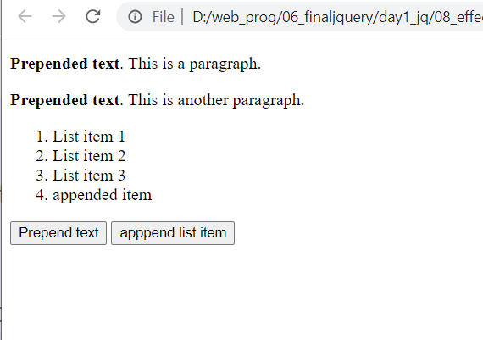
prepend and append
<!DOCTYPE html>
<html><head><script src="jquery-1.9.1.js">
</script><script>
$(document).ready(function(){
$("#btn1").click(function(){
$("p").prepend("<b>Prepended text</b>. ");
});
$("#btn2").click(function(){
$("ol").append("<li>appended item</li>");
});
});
</script></head>
<body>
<p>This is a paragraph.</p>
<p>This is another paragraph.</p>
<ol>
<li>List item 1</li>
<li>List item 2</li>
<li>List item 3</li>
</ol>
<button id="btn1">Prepend text</button>
<button id="btn2">Apppend list item</button>
</body>
</html>
.append(): This function Insert the data or content inside an element at last index. Means it puts the content inside an element (making the content its child) specified by the parameter at the end of element in the set of matched elements.
.append() puts data inside an element at last index and .prepend() puts the prepending elem at first index

Slide 6
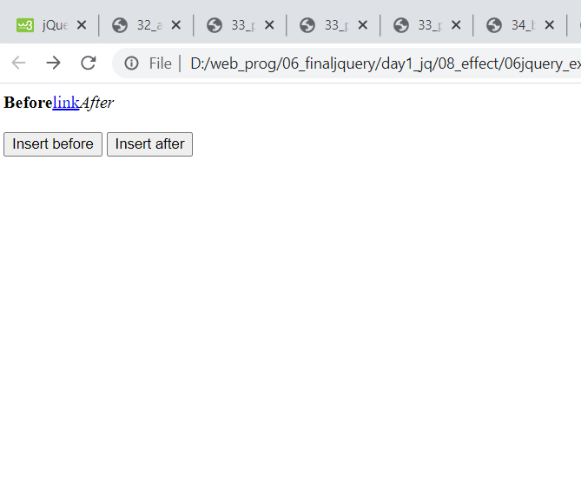
Before after
.after(): This function puts the element after the specified element. Or you can say that it insert data outside an element (making the content its sibling) in the set of matched elements.
<!DOCTYPE html>
<html><head>
<script src="jquery-1.9.1.js"></script>
<script>
$(document).ready(function(){
$("#btn1").click(function(){
$("a").before("<b>Before</b>");
});
$("#btn2").click(function(){
$("a").after("<i>After</i>");
});
});
</script></head><body>
<a href="vidyanidhi.com" alt="jQuery">link</a>
<br><br>
<button id="btn1">Insert before</button>
<button id="btn2">Insert after</button>
</body>
</html>
after() & before() insert content outside an element (making the content its sibling).

Slide 7
Remove Empty
<!DOCTYPE html>
<html>
<head><script src="jquery-1.9.1.js">
</script>
<script>
$(document).ready(function(){
$("button").click(function(){
$("#div1").remove();
});
});
</script></head><body>
<div id="div1" style="height:100px;width:300px;border:1px solid black;background-color:yellow;">
This is some text in the div.
<p>This is a paragraph in the div.</p>
<p>This is another paragraph in the div.</p>
</div><br>
<button>Remove div element</button><hr/>
To remove elements and content, there are mainly two jQuery methods:
remove() - Removes the selected element (and its child elements)
empty() - Removes the child elements from the selected element
</body>
</html>
Try: empty in this example and observe
In remove parent and child get removed from DOM .
Where as empty== div tag will stay but will remove its child and it will occupy space
empty();
remove();

